Slide 1

Finance Committee
Annual Town Meeting Report – 2024
Notes:
Thank you allowing me the time to discuss the state of our towns finances

Slide 2
Finance Committee (FinCom)
Appointed by Moderator
Works with Select Board and Town Management
Oversight of Town finances
Development of Financial Policies
Development of a balanced annual budget
Liaison with other committees and schools
Ensuring funding for service needs for the Town
  Spending
  Income (Taxation)
  Reserves
  Debts
2
Notes:
The Finance Committee is composed of volunteers who are appointed by the Moderator:
We represent you, the tax payer and we take that very seriously. We are extremely careful when approving expenditures that impact your tax rate.
And while we may respectfully disagree on various items as a FinCom this enables you to hear both sides of each article so that you can make the most informed decision possible.
This year the Fincom worked with TA Mike Johns and the Select Board to create town wide financial policies that we can use has a guide during the budgeting process.

Slide 3
Collaborative Budget Process
Establish budget guidelines using Financial policies
Budgets developed by Town Administrator, Departments and Commissions / Boards
Identification of estimated inflows
Review of Operating Budget by FinCom, Select Board
Review of Warrant Articles / Capital Items by FinCom, Select Board
Final Budgets presented at ATM
3
Notes:
Each year we strive for a collaborative Budget process. This year we also worked together to be balance all of the town resources and reserves to fnd the needs and services. I would like to thank
The finance committee for all their time & effort
Our Town administrator, the Select board, department heads, chiefs, and town staff for making this years budget process a true collaboration.
our boss, the Moderator

Slide 4
Balanced
Article 5 the Budget
Outflows
Inflows
Operating Budget
  General Government
  Education
  Debt servicing
  Pension and other benefits
  Risk Management (Insurance)
  Reserve funds
  Warrant Articles
  Major and non-recurring expenses
  Community Preservation (CPC) Items
Expected Tax receipts
Expected Local Receipts
Estimated State Aid
Transfers from Reserves
Community Preservation (CPC) Funds
Bonding/Debt
4
Notes:
The FinCom has simple budgets goals each year:
Minimize increases to the operating budget while provided needed services to the residents.
Manage the operating budget – no automatic increases, looked at historic data as we move forward
Proposed increased services are sperate warrant articles, not in article 5.
Manage long-term debt via capital planning process. This year the Fincom and select board worked togther to stand up a capital committee. This committee will in collaboration with the TA and their staff to manage our long term debt and future capital needs.
Address unfunded retiree benefits (OPEB)
Managed our Reserve using it stratiacally to offset items throughout the warrant.

Slide 5
FY25 Challenges
Develop a balanced budget despite large ABRSD assessment increase
Use Reserves within guidelines
Balance long term debt
Position for future needs, for example
  Fire Station
  Water
  Police Station
Notes:
FY 25 has been a budgeting challenge. But the finacom has been able to use our reserves to help offset the effect of unanticipated histocally high increase in our school assessment.
The fincom spent a great deal of time understanding how our decisions would effect the towns financial needs. Including next years operating budget, a new fire station, dealing water concerns and potentially a renovation of the police department just to name a few.

Slide 6
Levy – The amount a community raises through the property tax. The levy can be any amount up to the levy limit. , which is reestablished every year in accordance with provisions.
Levy Limit – Based on Proposition 2½ the Maximum Levy is established each year based on the prior year maximum increased by 2.5% plus new growth. For Boxborough the average increase has been ~5% over the past 5 years
Raise and Appropriate (R&A) – The Levy is calculated based on the Operating Budget and certain warrant articles
Override – allows a town to raise tax revenue beyond the Levy Limit (vote needed)
Definitions
Notes:
You will hear a lot about the Tax Levy and overrides.
Levy– the amount a community raises through property taxes
Levy limit –is the limit to the amount of taxes we can raise based on Prop 2.5 plus new growth over the last 5 years that amount as been 5%
An override vote is put forward so the town can raise taxes beyond the levy limit or prop 2.5%

Slide 7
Limited new growth (except 2023)
https://dlsgateway.dor.state.ma.us/gateway/
Notes:
With the exception Fy23 when the enclave came online. The towns has been limited to an average new growth of about $300K or 3% a year
Our Commercial tax base is down 6% over the last 10 years

Slide 8
Excess Levy Capacity has been declining
Average Levy (Tax) Limit Increase 2021-2024 5.0%
Average Levy(Tax) Increase 2021-2024 = 6.0%
Levy (Tax) increase FY25 = 9.4%
https://dlsgateway.dor.state.ma.us
Notes:
Due conservative, careful and thoughtful budgeting over the last 10 years the town has been able to tax under our tax levy limit. Our average tax increase in the last 3 fiscal years has been 6%. This year the average tax increase will be 9.4%. And the district as already indicated another significate increase for FY26.

Slide 9
FY25 Total Expenses and Revenue
FY25 | Outflows |  | Inflows
Operating Budget 2025 | $27,996,663 | Taxation | $26,971,554
Warrant Articles (R&A) | $285,500
Sub Total | $28,282,163 |  | $26,971,554
Warrant Articles (Non R&A) | $2,588,300 | Local Receipts | $1,355,800
State Charges | $97,205 | State Aid | $352,014
Overlay Reserve | $300,000 | From Reserves (Free Cash) | $1,010,500
 |  | From Reserves (Stabilization) | $171,000
 |  | Debt | $645,000
 |  | CPA Funds | $245,500
 |  | Other Funds | $516,300
Sub Total | $2,985,505 |  | $4,296,114
 | $31,267,668 |  | $31,267,668
*Estimated
9
Notes:
As noted in this slide we are using all of the towns resources to carefully balance all the items in the warrant this year. The funding of article and the budget this year as been done very purposefully to leave the town in as good a position as possible going into next year. In order to limit or avoid an override next year.

Slide 10
Operating Budget FY25 vs FY24
Operating Budget increases 7.87%
 | FY25 | FY24 | Change %
Town (non ABRSD) | $12,036,389 | $12,009,110 | 0.23%
AB Regional School (ABRSD) | $15,960,274 | $13,944,299 | 14.46%
Total Operating Budget | $27,996,663 | $25,953,409 | 7.87%
Notes:
The Town operating budget less AB school assessment was only 0.23%. AB school assessment is 14.46%. For a total operating budget increase of 7.87%

Slide 11
FY 25 Operating Budget Drivers -Town
The Town (non ABRSD) Budget increased by ONLY 0.23%.
  Reductions in long term debt payments ($300,000)
  Regionalization of Dispatch ($400,000+)
  Move from current Health Insurance provider to MIAA. Savings for this line Item will be not be seen until FY26.
  Increasing some staffing and programs.
    Go Boxborough
    Professional Development
    Promotions of a 4th Sergeant for the BPD.
Notes:
The Town operating budget less the AB assessment was only 0.23%. This low amount was archived through the
retirement of Long term debt ( library)
Regionalization of Dispatch– while this saves the town $400,000 this year. Beginning in FY 26 there will be a incremental increase over 5 years to will get a to a point of a $200k assessment.
TA mike Johns anticipated a unsustainable increase in our health insurance from our current provider and took the inititive to move the town to MIAA for our insurance needs-- those savings will be realized in FY26.
The Fincom thanks the TA and his staff for taking on an following through with these structural changes, that have allowed for increases services to the residients without outrages increases to the taxpayers.

Slide 12
FY 25 Operating Budget Drivers-Schools
Significant increase in the Acton Boxborough Regional School District (ABRSD) assessment.
  Boxborough’s assessment increased by 14.46% ($2,015,975)
  Total assessment $15,960,274.
  Large unanticipated charges from Acton Health Trust (HIT)
  Increases in Special Education (SPED) out of district tuition.
  Increases in SPED transportation costs
  Increased Boxborough student enrollment (3 year rolling average)
  The increase in the school budget was despite reductions from ‘level service’ including some staff reductions and program eliminations.
  The Finance Committee vote for the school budget was 5-3 in favor.
  Future increases of this magnitude are not sustainable for the town.
Notes:
The Districts operating FY25 budget is up 7.86% or $8.1 million increase.
This translates to a significant increase in the Boxborough assessment which is up 14.46%.
The largest budget busters is
Large unanticipated charges from the Acton Health Trust
Special education cost for out of district tuition and transportation
Increase enrollment for boxborough 3 year rolling average
The vote by the Fincom was split 5-3 in favor. The members of he fincom all agrees that future increase of this magnitude are not sustainable for the town. And the District as already indicated an additional 7% for FY26.
While a majority of the Fincom felt this increase justified the vote for the district assessment was not unanimous. But the feeling that these increases to our assessment were not sustainable were agreed to by the entire fincom.

Slide 13
Conclusion
Budget increase for FY25 is driven by ABRSD assessment
No need for an override for FY25 BUT…
Possible need for an override in next 1-3 years
Continued ABRSD assessment increases may drive an Operational Override
New Public Safety (Fire) facility may drive a Override
Notes:
No need for an override this year but the school assessment certainly pushes us closer to an override in the near future. Realistically sometime in the next 1-3 years Boxborough will be facing an operational override and additionally a possible override for a new fire station. We will continue to work for you the taxpayer to keep Boxborough affordable for everyone.

Slide 14
Finance Committee
New Members Welcome
Maria Neyland, Chair | Antony Newton, Vice Chair
Gary Kushner, Clerk | Keshava Srivastava
Bob Stemple | Becky Neville
John Connor | George Elenbaas

Slide 15
BACKUP SLIDES

Slide 16
2025 vs 2024 (sorted by $ change)
 | FY25 | FY24 | Change $ | Change %
A/B Regional School | $15,960,274 | $13,944,299 | $2,015,975 | 14.46%
Employee Benefits | $2,982,686 | $2,659,070 | $323,616 | 12.17%
Town Government | $2,138,282 | $1,950,935 | $187,347 | 9.60%
Public Works | $1,430,026 | $1,358,951 | $71,075 | 5.23%
Culture & Recreation | $492,059 | $469,465 | $22,594 | 4.81%
Health Services | $278,152 | $256,184 | $21,968 | 8.58%
Reserve Fund | $168,000 | $155,000 | $13,000 | 8.39%
Vocational/Technical Schools | $171,669 | $304,641 | ($132,972) | -43.65%
Protection | 3,347,023 | 3,520,732 | ($173,709) | -4.93%
Debt Service | $1,028,492 | $1,334,132 | ($305,640) | -22.91%
Total Budget | $27,996,663 | $25,953,409 | $2,043,254 | 7.87%

Slide 17
Debt Repayments – 10 years
Does not include future debt requirements
  FY25 Bonding $645,000
  Fire Station (TBD)
  Policy: Debt service should not exceed 10% of revenues (FY25 = $2.9MM)
4.2% of Operating Budget

Slide 18
Shift from commercial to residential tax base
Fiscal Year | Residentail Levy as a % of Total | Commercial Levy as a % of Total
2015 | 75.67 | 24.33
2016 | 76.09 | 23.91
2017 | 76.83 | 23.17
2018 | 77.83 | 22.17
2019 | 78.65 | 21.35
2020 | 79.40 | 20.60
2021 | 78.79 | 21.21
2022 | 79.63 | 20.37
2023 | 81.92 | 18.08
2024 | 81.81 | 18.19
https://dlsgateway.dor.state.ma.us/gateway

Slide 19
Commercial tax base is declining
2015 Commercial Tax = 24% of Total
2024 Commercial Tax = 18% of Total
Notes:
There has been a 6% decrease in the commercial tax base over the last 10 years. This 6% was shifted to the residential tax payers.

Slide 20
Town Finance Policy
Source of funds | Commentary
Free Cash | Maintained at >5% of Operating Budget*
Reserve Fund | For emergency needs only*Fund at 0.6% of Operating Budget*
Stabilization Fund | Maintained at >5% of Operating Budget*
Overlay Reserve Fund | Determined by Assessor under State Guidelines*
Debt Policy
20
Notes:
Sources of reserves and how we funded

Slide 21
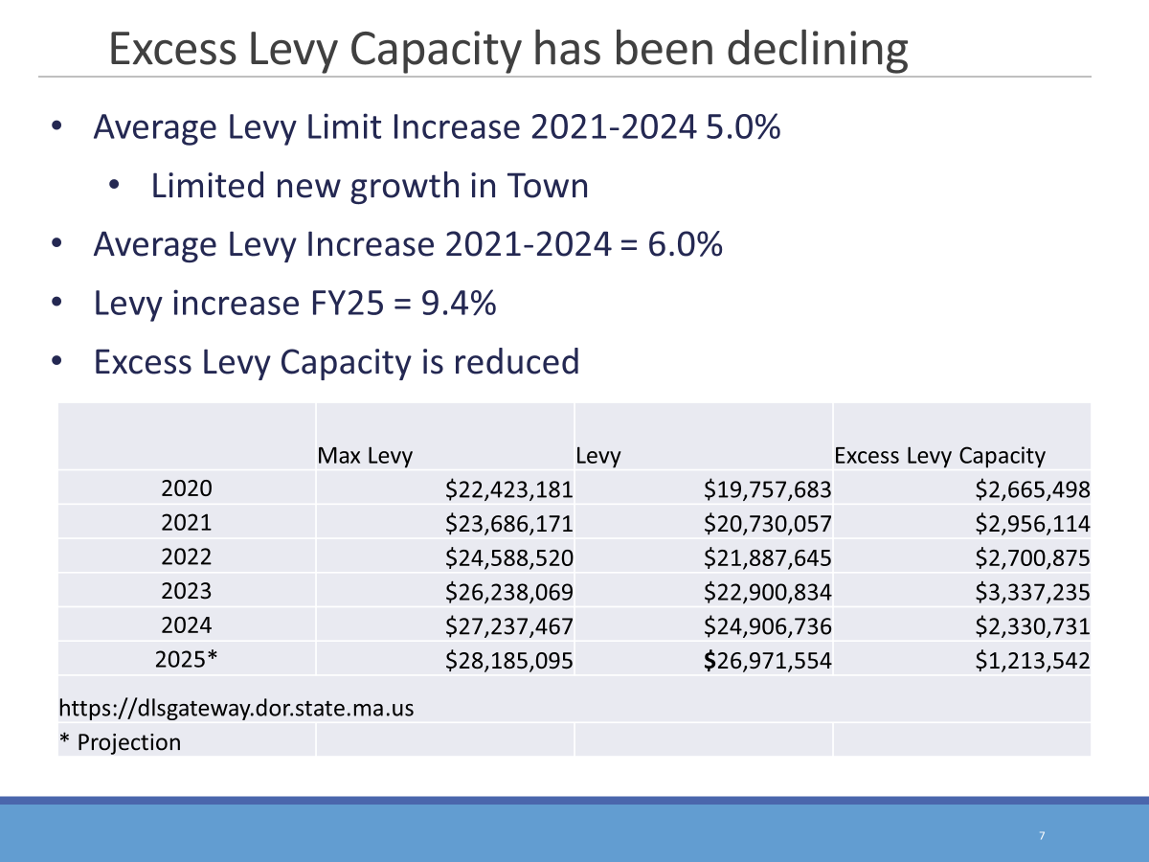

Slide 22
Levy Capacity Reduced 2023-2025
High New Growth Revenue in 2023
https://dlsgateway.dor.state.ma.us/gateway/

Slide 23
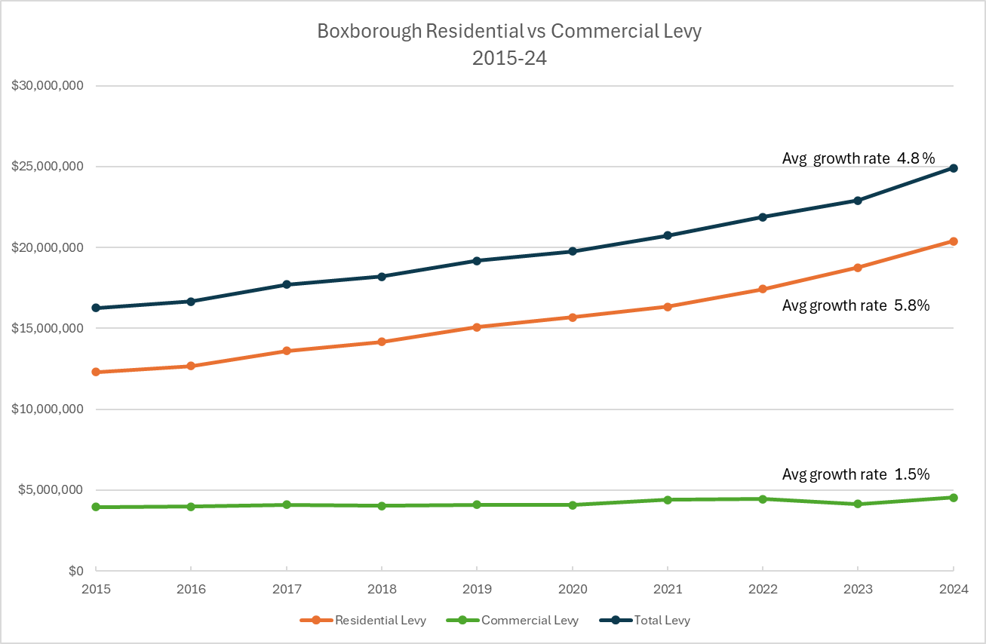

Slide 24
Average Taxes last 5 years
Fiscal Year | Single Family Tax Bill
2020 | $10,179
2021 | $10,607
2022 | $11,420
2023 | $11,868
2024 | $12,665
2025 Est. | $13,857
https://dlsgateway.dor.state.ma.us/gateway
Notes:
5 year window show on average 6% increase a year

