Slide 1


Town of Boxborough
Climate Change Survey
Summary of Results
Suresh Jasrasaria
Chris DeLise
Boxborough Sustainability Committee Members
Francie Nolde, Chair
Richard Garrison
Larry Grossman
Suresh Jasrasaria
Palmer Moore
Barbara Salzman
Boxborough Resident:
Chris DeLise

Slide 2
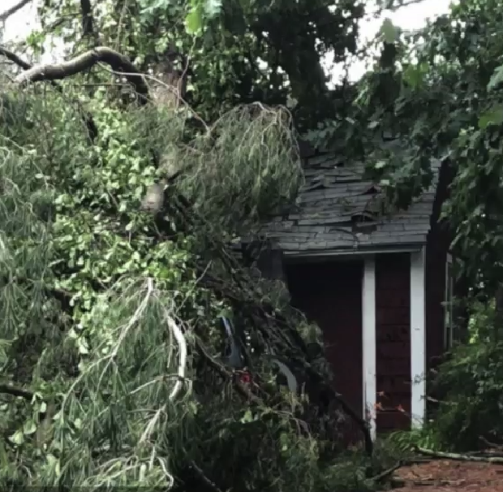
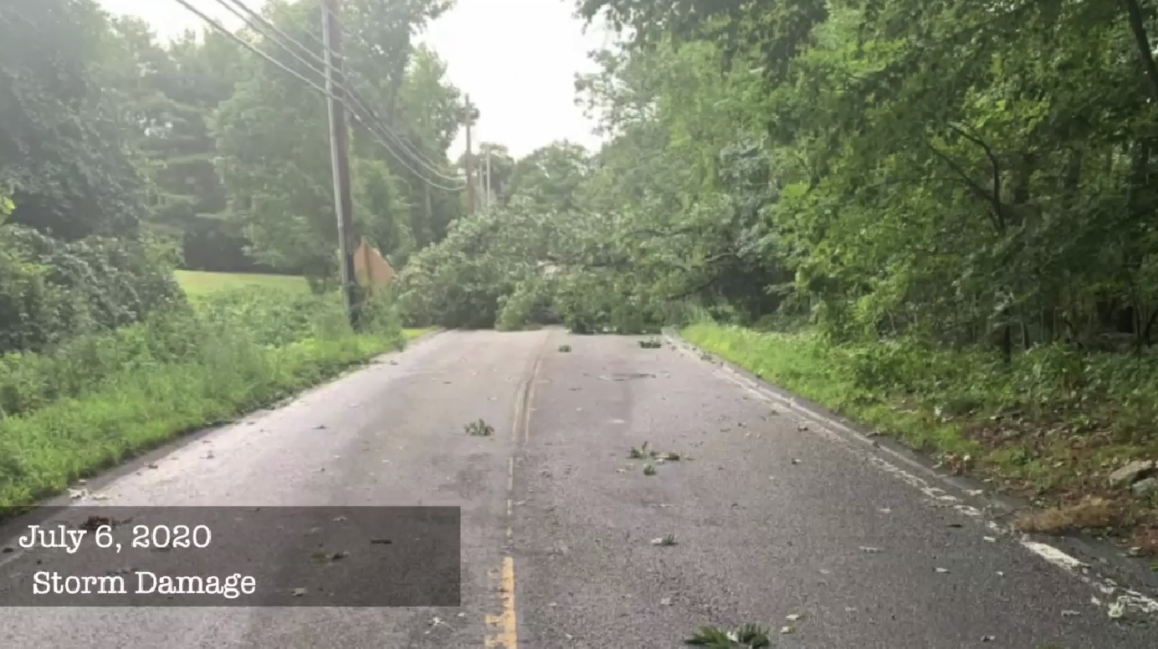
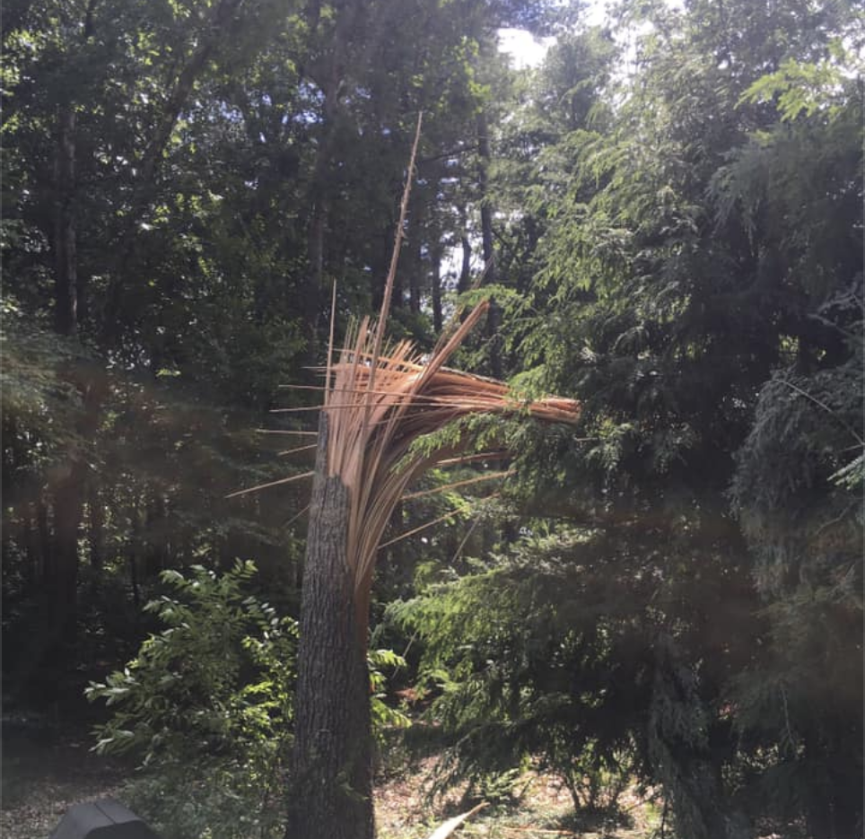
Extreme Weather Events
Microburst Storm Damage in Boxborough
July 6, 2020
July 6, 2020
Storm Damage
July 6, 2020
Storm Damage

Slide 3
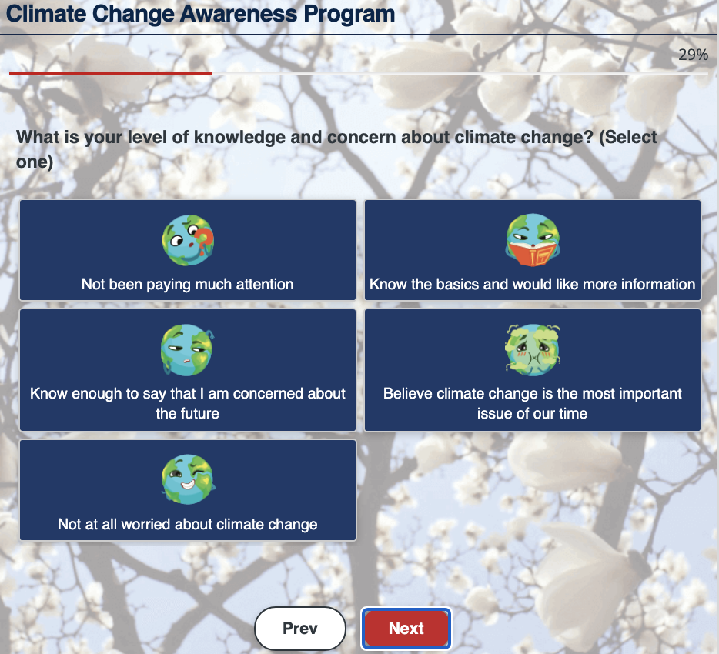
Boxborough Climate Change Survey Objectives
Boxborough Sustainability Committee conducted a Climate Change Survey of town residents from Nov 29, 2020 to Feb 18, 2021
Awareness: To understand what the community currently knows about climate change
Education: To find out what the community thinks it needs to know about climate change
Action: To solicit some ideas from the community on what should be done about climate change and by whom
Urgency: To assess the community’s willingness to commit to actions (objective)

Slide 4
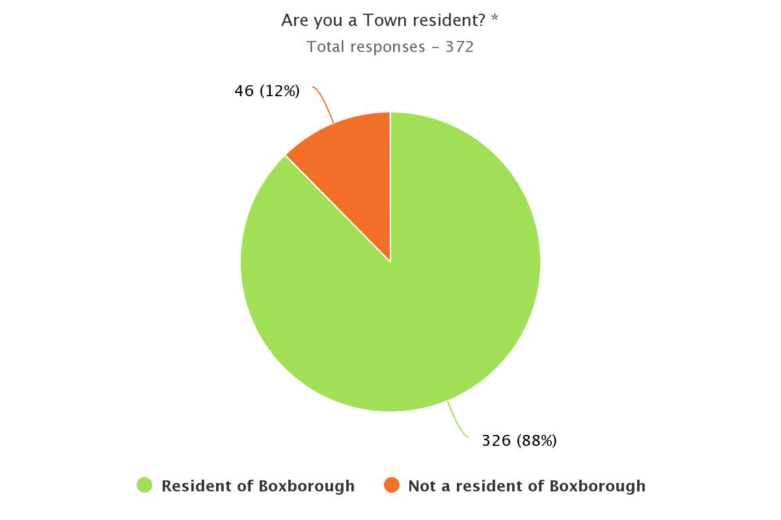
Response Statistics

Slide 5
Key Takeaways
Majority of Boxborough Residents:
  Believe that climate change is real.
  Want to learn more about climate change.
  Want to take action now to mitigate the impacts of climate change.
  Believe Government, Business and Community partnerships should lead climate change action in Boxborough.

Slide 6
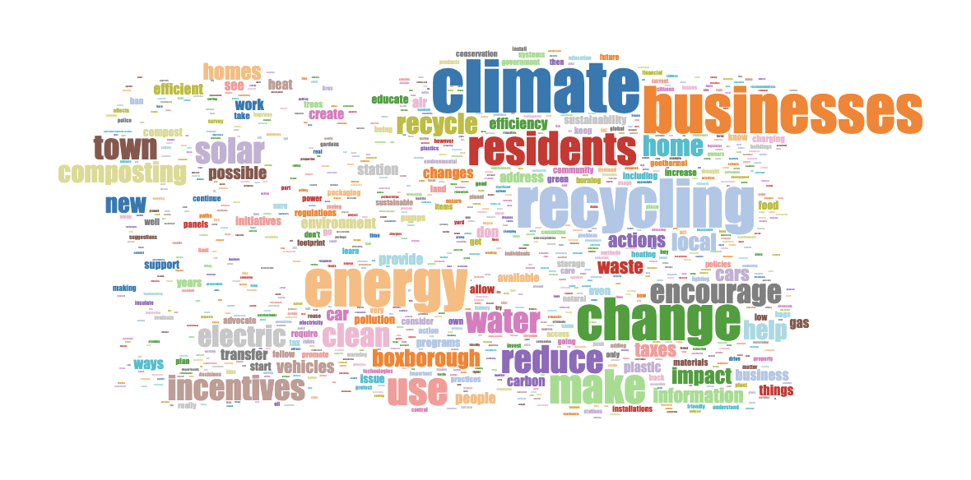
Sentiment Analysis
We analyzed the sentiment in the 365 suggestions received from town residents using Machine Learning algorithms.
Survey Question 6
What suggestions do you have for climate change actions in Boxborough?
For Boxborough Residents
(145 suggestions)
For Boxborough businesses
(98 suggestions)
For the Boxborough Select Board
(122 suggestions)
Prominent sentiments:
Reuse, Reduce, Recycle
(more than 100 mentions)
Use solar
(more than 50 mentions)
Get off fossil fuels
(more than 30 mentions)
Encourage with incentives
(more than 30 mentions)

Slide 7
Sustainability Committee
Actions and Next Steps
Informed by the results from the Climate Change Survey the Sustainability Committee has updated its:
Warrant Article for the June 2021 Town Meeting
  To consider and strive to advance environmental sustainability.
Sustainability Policy
  To incorporate commitment to environmental sustainability.

